Slide 1


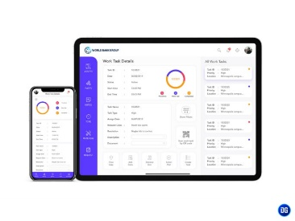





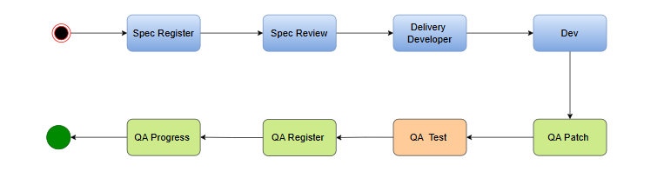
Spec Reg
Delivery
Dev
QA Request
QA Team Test
Output
Contract
Other Work

